Slide 1


Ram Kiran Devireddy
13th Sept 2021

Slide 2

Outline
Executive Summary
Introduction
Methodology
Results
Conclusion
Appendix

Slide 3
Executive Summary
Summary of methodologies
Collection of Falcon 9 launch data via SpaceX API, and web scrapping, then store it into IBM Db2 for analytics.
Data cleaning, replacing missing values with either mean of that table or 0.
Visualization of the data
Finally, performance of a predictive analysis to train and evaluate a best model and give prediction over the success of future landings.
Summary of all results
When Payload was greater than 7500 kg falcon rocket had a higher chance of successful landing.
Among 11 orbit types ES L1, GEO, HEO, SSO were 100 successful with less than 6000 kg payload.
SpaceX has 4 launch sites, one is near California, the other three is near Florida and South Texas. All the sites are in near proximity to ocean and all the sites are bit far away from the city.
All models performed similarly when trained with the data at hand.

Slide 4
Introduction
Project background and context
SpaceX is a company that aims to make commercial space travel more affordable for everyone.
This company can launch rockets for a cost of around 60 million dollars. In contrast, other providers require165 million dollars for one launch. This is due to the fact that SpaceX can reuse the first stage of the rocket Falcon9.
The primary cost saving agent is the high success rate of stage 1 landing and thus its reusability in future launches.
The challenge here is to set a right costing fore cast of the rocket launches through predicting its potential to land stage 1 successfully.
Problems you want to find answers
What are features that contributes the most to predict whether the stage one of the rocket will and land successfully?
Can we predict if we new launches will be successful based on our trained model. What will be the accuracy of our predictions?

Slide 5


Slide 6
Methodology
Executive Summary
Data collection methodology:
Data was collected using the SpaceX REST API and Wikipedia Web scrapping using python BeautifulSoup.
Perform data wrangling
Data was processed using python pandas and numpy library.
Perform exploratory data analysis (EDA) using visualization and SQL
Perform interactive visual analytics using Folium and Plotly Dash
Perform predictive analysis using classification models
Classification models (Experiment usability and compatibility of SVM, Tree maps, KNN, Logistic
Regression optimizing parameters) were built, evaluated and tuned using sklearn.

Slide 7
Data Collection
The data is collected:
Using SpaceX API.
Using BeautifulSoup library to scrap data from the Wikipedia page.

Slide 8
Data Collection – SpaceX API
Request launch data from SpaceX URL using given API.
Extract the data from the response.
Pre-process and construct the data.
Store the data in CSV file.
GitHub
Extract
Data from API request.
Convert
To .json static files.
Clean
Data for relevance in dictionary format.
Export
in .csv format for further analysis.

Slide 9
Data Collection - Scraping
Request for the Wikipedia page.
Parse the table data from html text using beautifulSoup4 library.
Create pandas data frame from table data.
Construct the data and store it in CSV.
GitHub
Extract
From the Wikipedia page.
Convert
To BeautifulSoup4 parse-able format.
Clean
Data for relevance in dictionary format.
Export
in .csv format for further analysis.

Slide 10
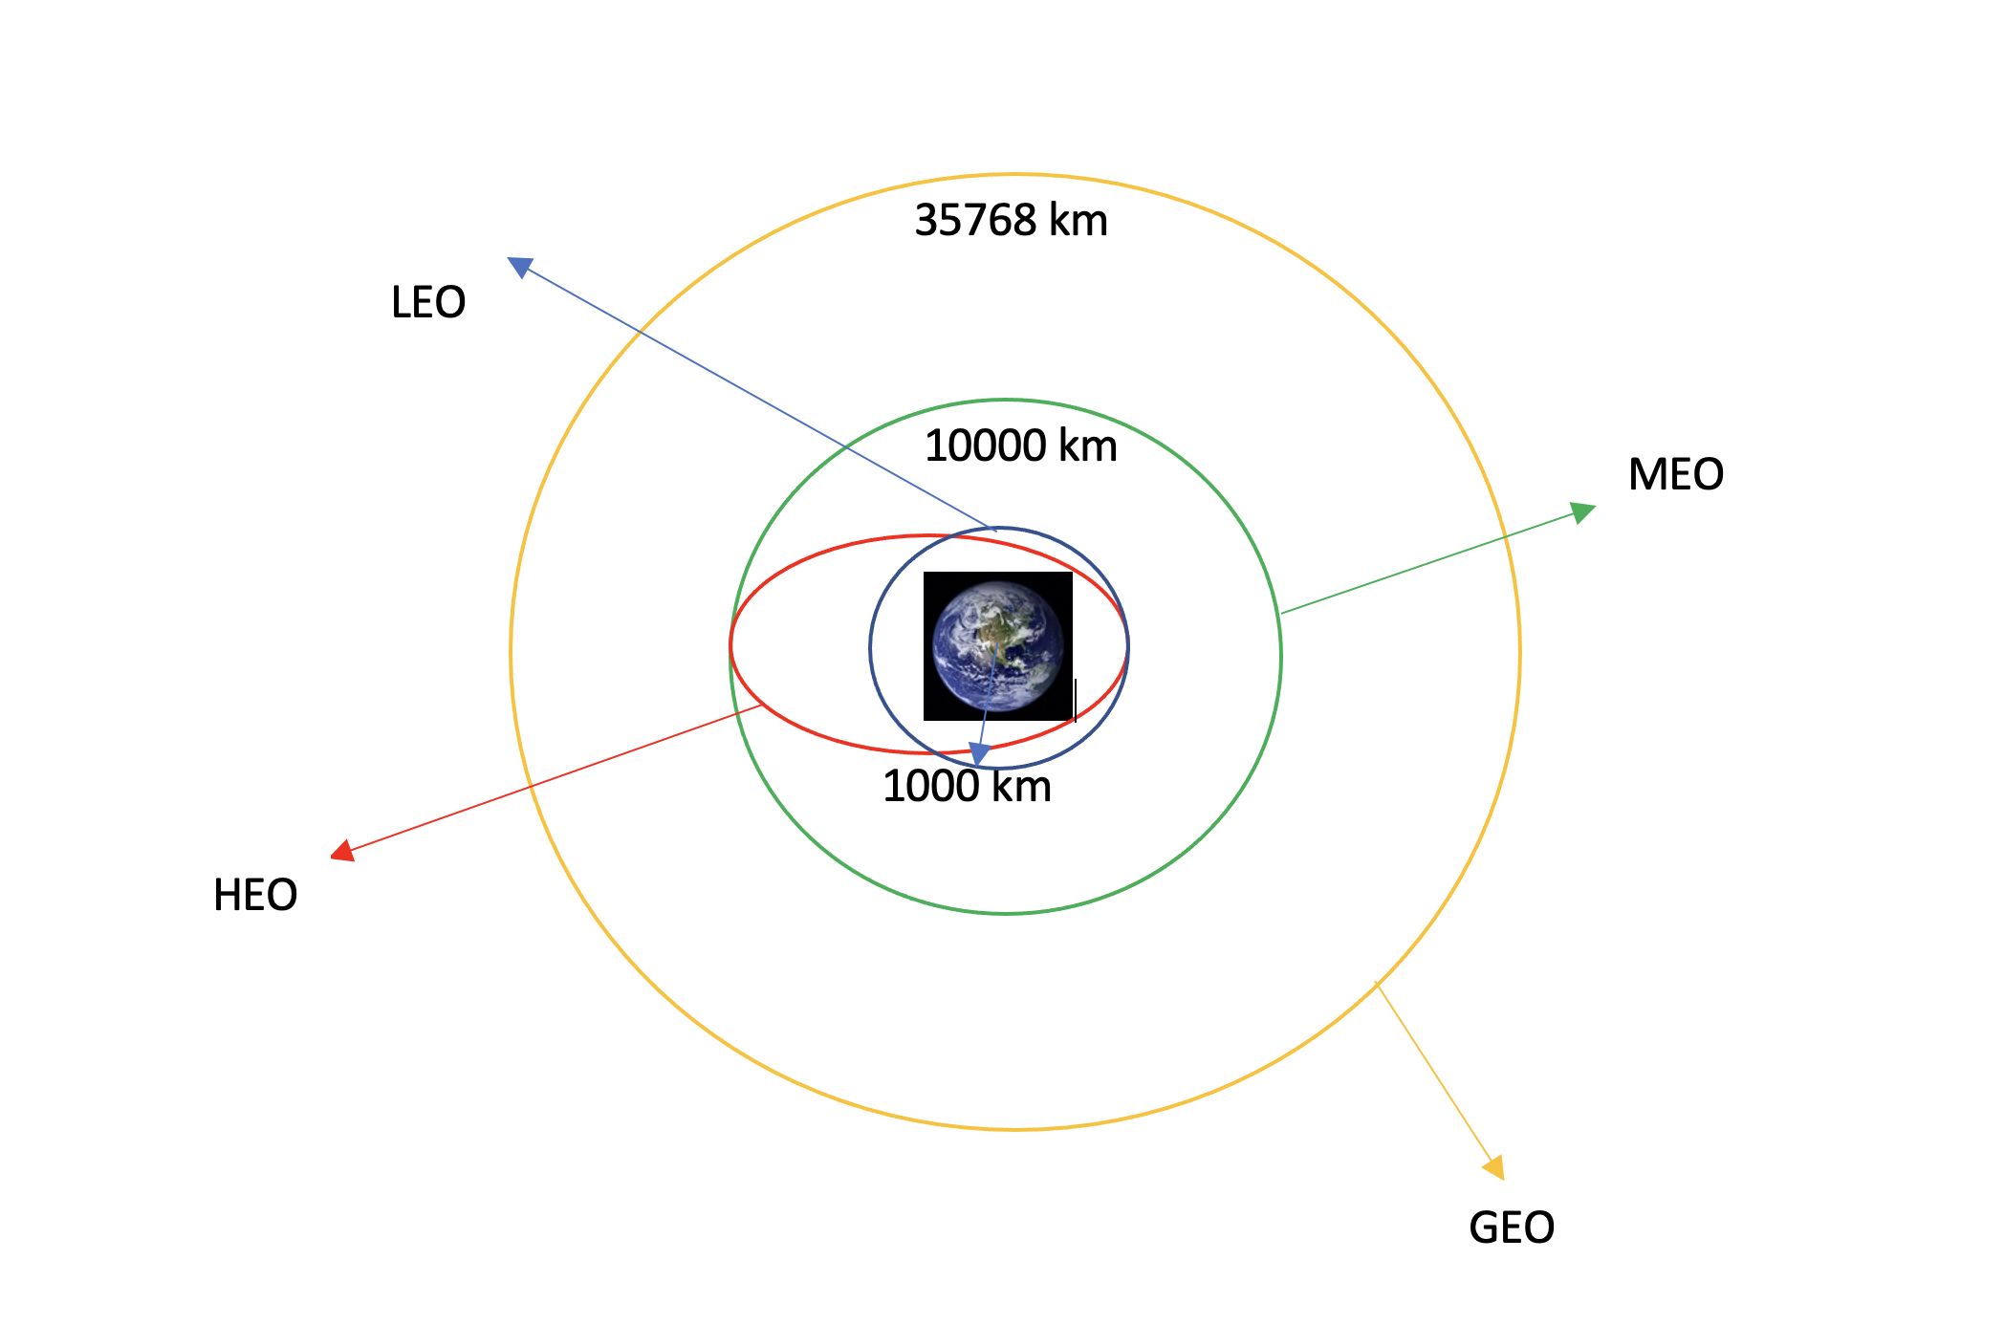
Data Wrangling
Calculate the number of launches per site.
Number of occurrence of each orbit.
Number of occurrences of outcome per orbit.
Create landing outcome label.
GitHub
Different orbits in which flight can launched.

Slide 11
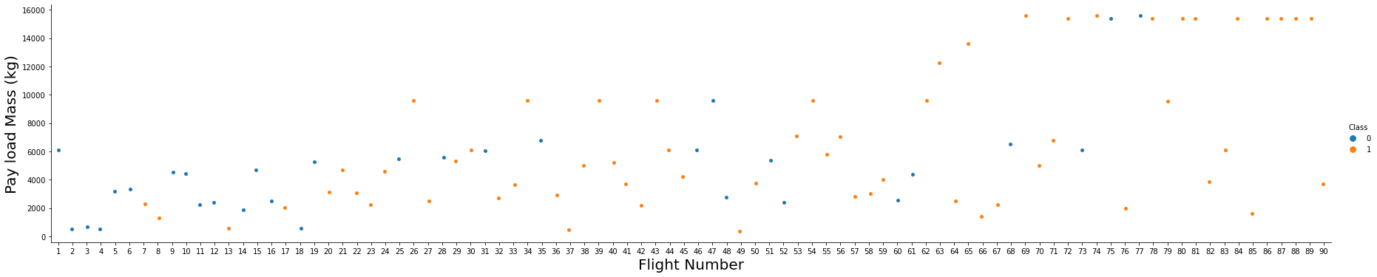
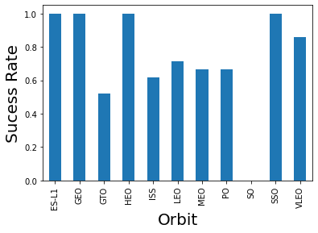
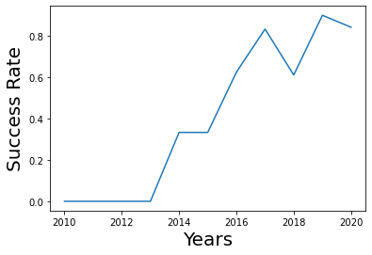
EDA with Data Visualization
GitHub

Slide 12
EDA with SQL
Display the names of the unique launch sites in the space mission.
Display 5 records where launch sites begin with the string ‘CCA’ .
Display the total payload mass carried by boosters launched by NASA.
Display average payload mass carried by booster version ‘F9 v1.1’.
List the date when the first successful landing outcome in ground pad was achieved.
List the names of the boosters which have success in drone ship and have payload mass greater than 4000 but less than 6000.
List the total number of successful and failure mission outcomes.
List the names of the booster versions which have carried the maximum payload mass.
List the failed landing outcomes in drone ship, their booster versions, and launch site names for in year 2015.
Rank the count of landing outcomes (such as Failure (drone ship) or Success (ground pad)) between the date 2010 06 04 and 2017 03 20 , in descending order.
GitHub

Slide 13
Build an Interactive Map with Folium
Map objects which are created and added to the folium map are given below:
Markers: Added to mark a specific area with a text label on a specific coordinate.
Circles: Added to highlight circle areas with a text label on a specific coordinate.
Marker Cluster: Marker clusters were used to simplify the containing many markers having the same coordinates.
Mouse Position: Used to get coordinate for a mouse over a point on the map (proximities). It helps to find the coordinates easily of any points of interests while exploring the map.
Polyline: It draws polyline overlays on a map. It was used to denote the distance between a launch site and its proximities(such as Railway station, city, etc.).
GitHub

Slide 14
Build a Dashboard with Plotly Dash
Pie chart (total launches for a selected site or the total sites collection)
Shows relative proportions of different sites successful landing distribution.
Shows % of success vs. failure for a given site.
Scatter Plot
Showing the correlation between Outcome and Payload Mass(Kg) for different Booster Versions with freedom of selection of the range of payload mass of Interest.
GitHub

Slide 15
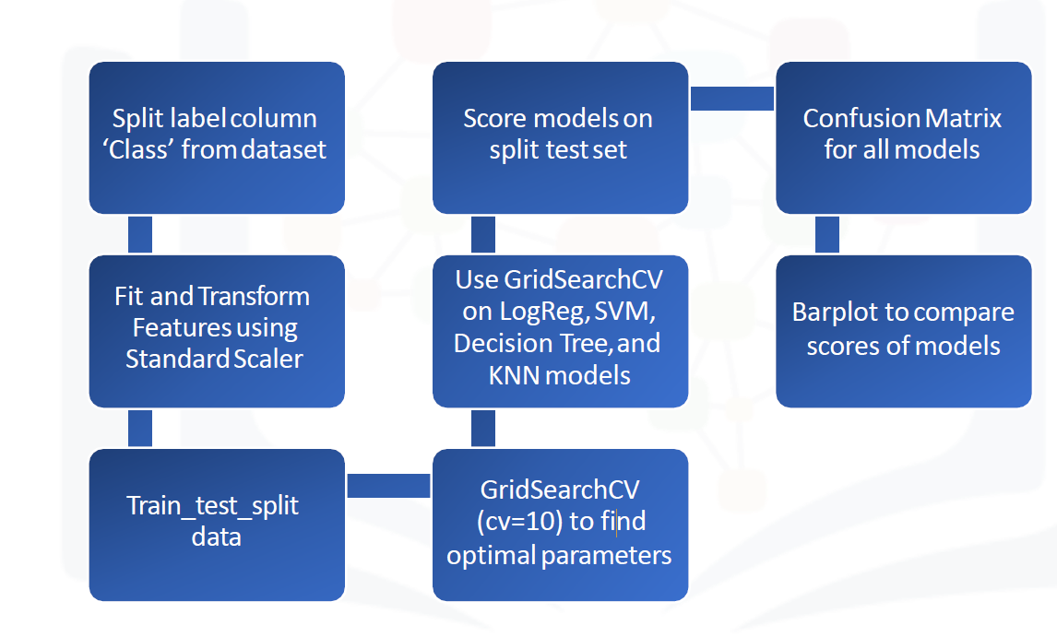
Predictive Analysis (Classification)
GitHub

Slide 16
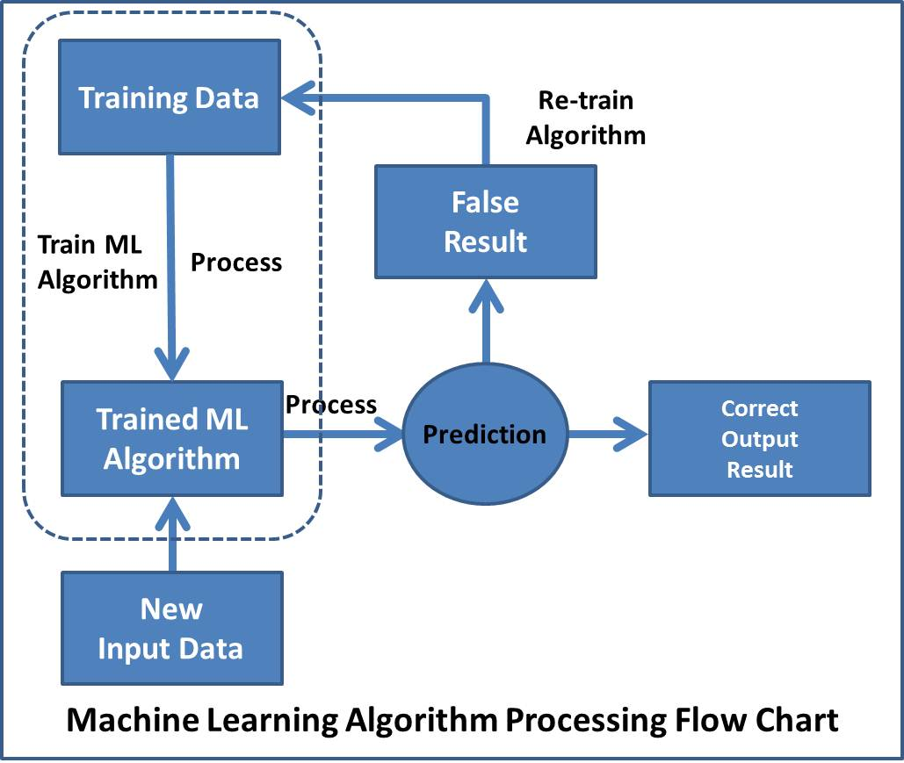
Results
Models were built using Scikit-Learn, data were previously normalized and models hyper parameters were found using a Grid Search with a 10 fold cross validation, in the end the best performing model has been selected based on accuracy.
GitHub

Slide 17


Slide 18
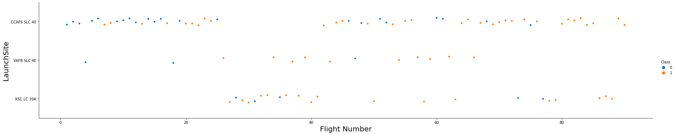
Flight Number vs. Launch Site
This chart seems to indicate that a “young” launching site will probably a lower success rate than one which had a lot of rocket launched from.

Slide 19
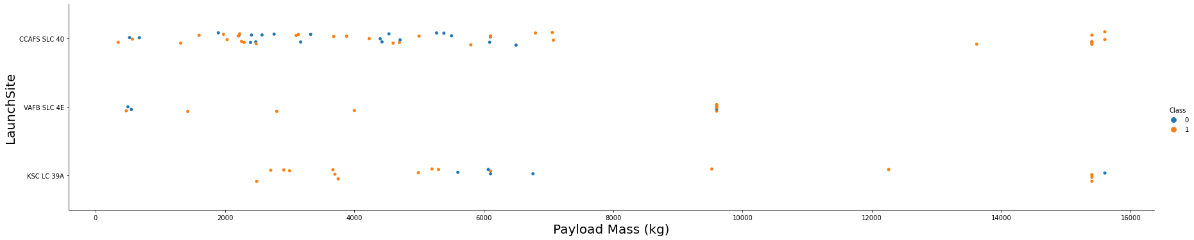
Payload vs. Launch Site
It seems like a lot of rocket launched had a payload between 500kg and 6000kg. Also, the launching site VAFB SLC 4E seems to be a site where there are not that much rocket launched. An impact of the payload could be possible but it will need further analysis.

Slide 20
Success Rate vs. Orbit Type
There is a strong correlation between these two indeed as we can observe the SO or GTO Orbit type are quite risky as the success rate is below 0.6. However, some orbit type provide a 1.0 success rate which is perfect but can hide suspicious data. Indeed if for this orbit type only one rocket has been launched the reliability of this hypothesis is null.

Slide 21
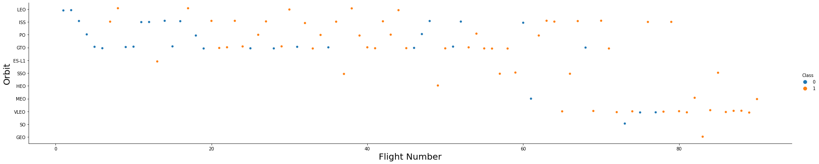
Flight Number vs. Orbit Type
This chart confirmed what has been said before, some Orbit type have only couples of Flights in their history and thus make data quite confusing. However for the GTO,VLEO and ISS it seems like there are enough data to be confident on those data.

Slide 22
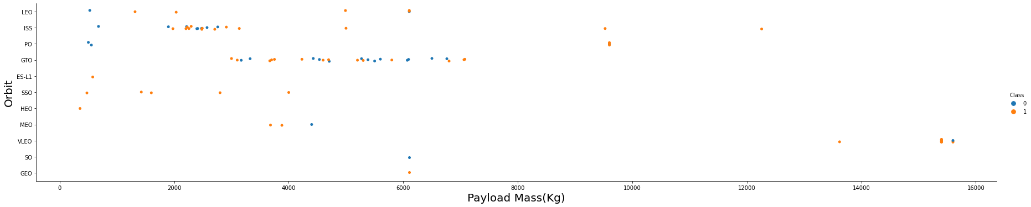
Payload vs. Orbit Type
Here we can observe that certain sites have a strong relation with the payload mass, for example the GTO and ISS.

Slide 23
Launch Success Yearly Trend
Here the chart demonstrates that as Humans learn more and more through the years thanks of Sciences, it results in a significant rocket launches success rate increasing.

Slide 24
All Launch Site Names
Launch sites are :
CCAFS LC-40
CCAFS SLC-40
KSC LC-39A
VAFB SLC-4E
SQL QUERY: select distinct(launch_site) from SPACEXTBL;

Slide 25
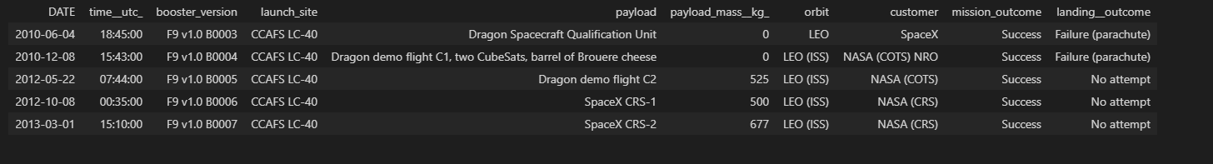
Launch Site Names Begin with 'CCA'
5 records where launch sites begin with `CCA` :
SQL QUERY: select * from SPACEXTBL where launch_site like 'CCA%' limit 5;

Slide 26
Total Payload Mass
The total payload carried by boosters from NASA is 45596 kg.
SQL QUERY: select sum(payload_mass__kg_) from SPACEXTBL where customer = 'NASA (CRS)';

Slide 27
Average Payload Mass by F9 v1.1
The average payload mass carried by booster version F9 v1.1 is 2534 kg.
SQL QUERY: select avg(payload_mass__kg_) from SPACEXTBL where booster_version like 'F9 v1.1%';

Slide 28
First Successful Ground Landing Date
The dates of the first successful landing outcome on ground pad was 2015-12-22.
SQL QUERY: select min(DATE) from SPACEXTBL where landing__outcome = 'Success (ground pad)';

Slide 29
Successful Drone Ship Landing with Payload between 4000 and 6000
List the names of boosters which have successfully landed on drone ship and had payload mass greater than 4000 but less than 6000:
F9 FT B1032.1
F9 B4 B1040.1
F9 B4 B1043.1
SQL QUERY: select distinct(booster_version) from SPACEXTBL where landing__outcome = 'Success (drone ship)' AND payload_mass__kg_ > 4000 AND payload_mass__kg_ < 6000;

Slide 30
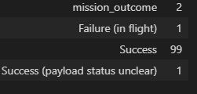
Total Number of Successful and Failure Mission Outcomes
The total number of successful and failure mission outcomes :
SQL QUERY: select mission_outcome,count(*) from SPACEXTBL group by mission_outcome;

Slide 31
Boosters Carried Maximum Payload
List the names of the booster which have carried the maximum payload mass
SQL QUERY: select distinct(booster_version) from SPACEXTBL where payload_mass__kg_ = (select max(payload_mass__kg_) from SPACEXTBL);
Booster_version
F9 B5 B1048.4
F9 B5 B1048.5
F9 B5 B1049.4
F9 B5 B1049.5
F9 B5 B1049.7
F9 B5 B1051.3
F9 B5 B1051.4
F9 B5 B1051.6
F9 B5 B1056.4
F9 B5 B1058.3
F9 B5 B1060.2
F9 B5 B1060.3

Slide 32
2015 Launch Records
List the failed landing_outcomes in drone ship, their booster versions, and launch site names for in year 2015:
SQL QUERY: select landing__outcome,booster_version,launch_site,date from SPACEXTBL where Date like '2015%' and landing__outcome = 'Failure (drone ship)';
landing__outcome | booster_version | launch_site | DATE
Failure (drone ship) | F9 v1.1 B1012 | CCAFS LC-40 | 2015-01-10
Failure (drone ship) | F9 v1.1 B1015 | CCAFS LC-40 | 2015-04-14

Slide 33
Rank Landing Outcomes Between 2010-06-04 and 2017-03-20
Rank the count of landing outcomes (such as Failure (drone ship) or Success (ground pad)) between the date 2010-06-04 and 2017-03-20, in descending order
SQL QUERY: select landing__outcome,count(landing__outcome) as count from SPACEXTBL where DATE BETWEEN '2010-06-04' and '2017-03-20' GROUP BY landing__outcome ORDER BY count(landing__outcome) DESC;
landing__outcome | COUNT
No attempt | 10
Failure (drone ship) | 5
Success (drone ship) | 5
Controlled (ocean) | 3
Success (ground pad) | 3
Failure (parachute) | 2
Uncontrolled (ocean) | 2
Precluded (drone ship) | 1

Slide 34

3

Slide 35
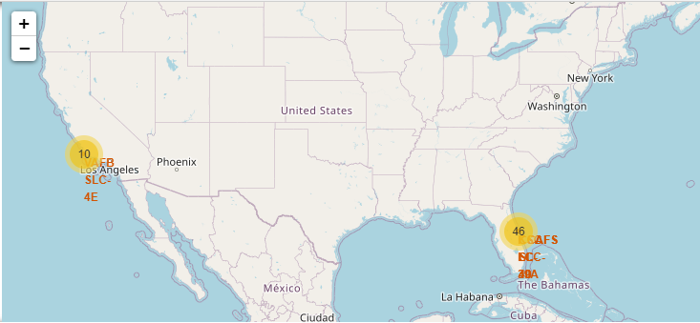
SPACEX LAUNCH SITES
Here we can observe launching sites in the US marked in orange, it is a little bit hard to see in Florida as the three sites are very close.

Slide 36
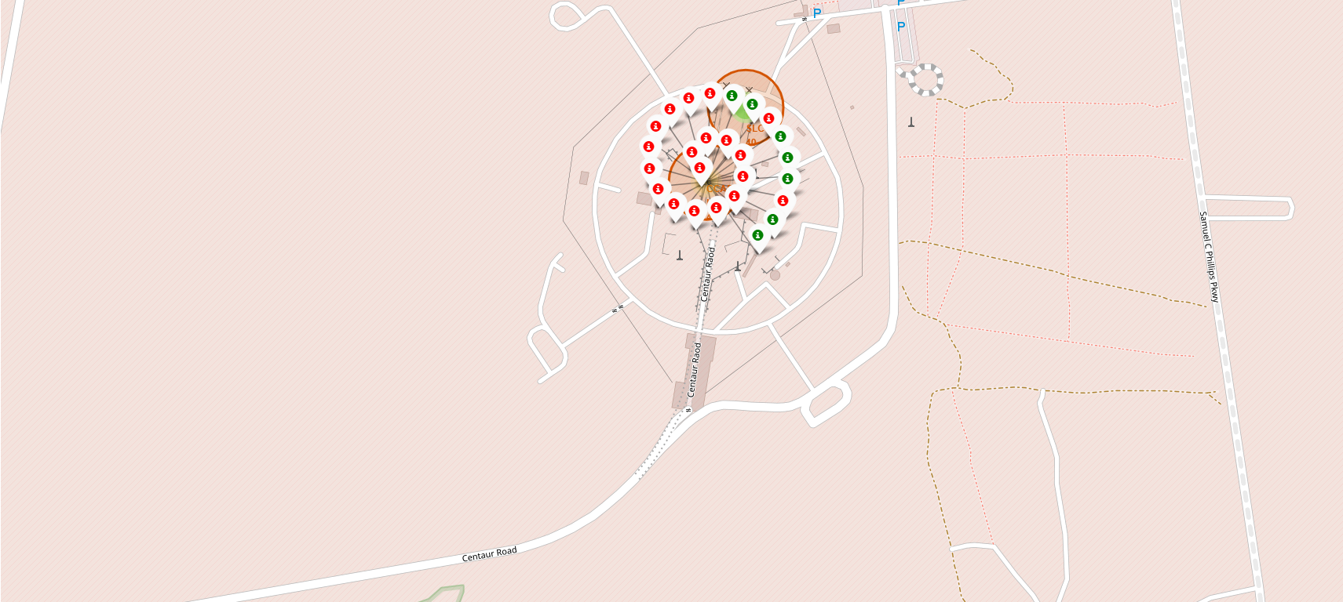
SUCCESSFUL AND FAILED LAUNCHES
Marker clusters is used to simplify the map containing many markers having the same coordinate.
Successful launches are marked using a green marker and failed launches are marked using a red marker.

Slide 37
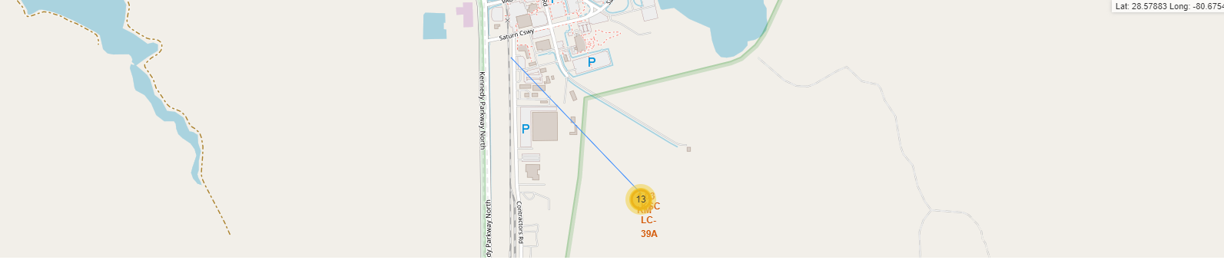
DISTANCE FROM LAUNCH SITE TO NEAREST RAILWAY STATION
The screenshot show the distance between launch site and nearest railway station.

Slide 38

4

Slide 39
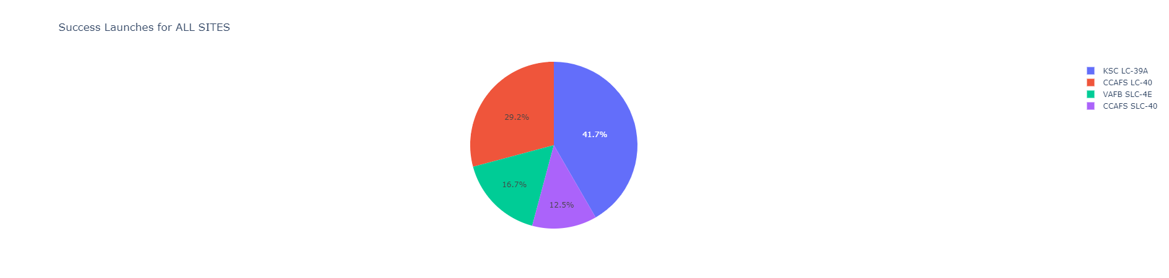
SUCCESSFUL LAUNCHES BY SITE
“KSC LC 39A” has the highest success ratio where as “VAFB SLC 4E” had the lowest success ratio among all four launch sites.

Slide 40
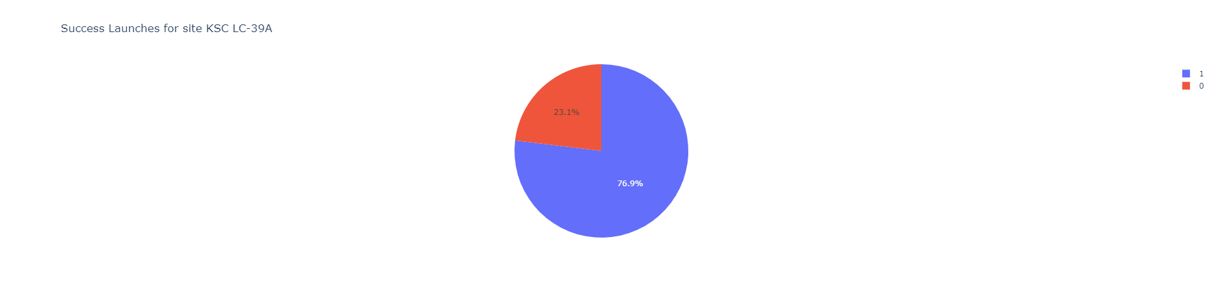
SITE WITH HIGHEST LAUNCH SUCCESS RATIO
The KSC LC-39A has almost a 77% of success ratio and a 23% failure ratio.

Slide 41
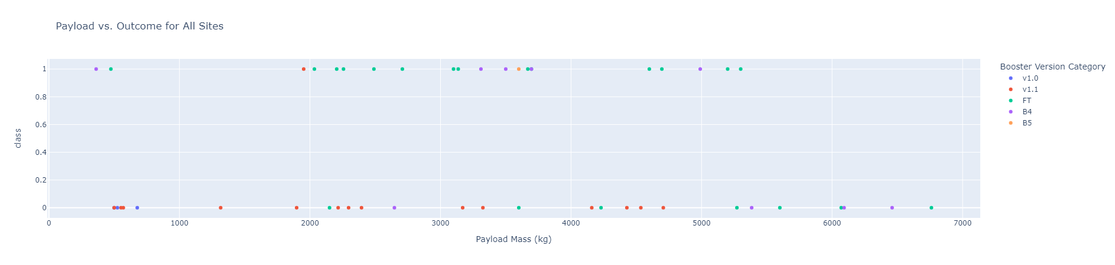
PAYLOAD VS. LAUNCH OUTCOME
FT booster have highest success rate while v1.1 have least success rate.

Slide 42

5

Slide 43
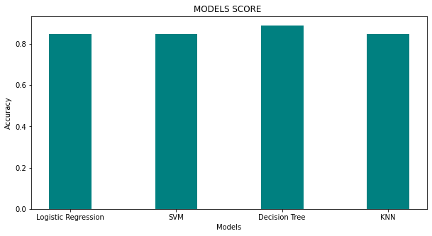
Classification Accuracy
The best model based on the accuracy is a Decision Tree Classifier with a score of 0.884.

Slide 44
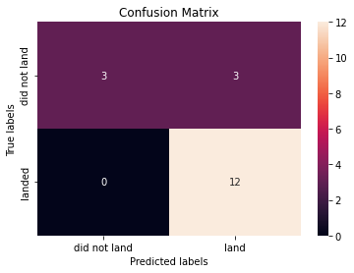
Confusion Matrix
The Confusion Matrix of the Decision Tree Classifier
True Positive : 12
False Negative : 0
True Negative : 3
False Positive : 3
The model is quite interesting as it predicts a lot of times the good labels, however 3 times it predicted the success of the mission and the mission failed. Reducing the amount of False Positive would be a good idea to avoid spending Millions and years of work.
It could be done using Boosting or maybe look at a model with a lower accuracy but a better precision.

Slide 45
Conclusions
There are many parameters when considering launching rockets in space.
The Booster version is definitely one of this essential parameter.
The Orbit, Payload Mass are also important.
Machine Learning models can really helps to understand if a mission will be a success or a failure as it will learn from data of all previous launches. As we saw a model is able to predict with a high accuracy the reliability of a mission.
However, more data would be useful to have better, I have no doubt that engineer and scientists use these data in their predictions.

Slide 46


